Slide 1
Greedy Algorithms
Oswald c
The class notes are a compilation and edition from many sources by materials from CLRS, Anany Levitin, Richard Anderson, etc. The faculty does not claim intellectual property or ownership of the lecture notes. Thanks to them!

Slide 2
Definition
A greedy algorithm for an optimization problem always makes the choice that looks best at the moment and adds it to the current sub solution (i.e. Hopes that ''local optimal'' choices lead to ''global optimal'. Solution).
Greedy algorithms don’t always yield optimal solutions, but a feasible solution. When greedy yields optimal soln., they’re usually the simplest and most efficient algorithms available.
Simple examples:
Playing chess by making best move without look ahead
Giving fewest number of coins as change

Slide 3
What makes a greedy algorithm?
Feasible
Has to satisfy the problem’s constraints
Locally Optimal
The greedy part
Has to make the best local choice among all feasible choices available on that step
If this local choice results in a global optimum then the problem has optimal substructure
Irrevocable
Once a choice is made it can’t be un-done on subsequent steps of the algorithm
Simple and appealing, but don’t always give the best solution

Slide 4
A real time example…
Maximization
Student requesting for marks in Unit test to maximize the score.
Minimization
Student requesting for penalties in Unit test to be minimized.
- sometimes he/she may become the topper in the class in both the cases.

Slide 5
The 0/1 Knapsack problem
Given a knapsack with weight W > 0.
A set S of n items with weights w_{i} >0 and profits p_{i}> 0 for i = 1,…,n.
S = { (item₁, w₁, p₁ ), (item₂, w₂, p₂ ) , . . . , ( item_{n,} w_{n}, p_{n} ) }
Find a subset of the items which does not exceed the weight W of the knapsack and maximizes the profit.
The name "knapsack problem" dates back to the early works of the mathematician Tobias Dantzig (1884–1956), and refers to the commonplace problem of packing the most valuable or useful items without overloading the luggage
A 1999 study of the Stony Brook University Algorithm Repository showed that, out of 75 algorithmic problems, the knapsack problem was the 19th most popular

Slide 6
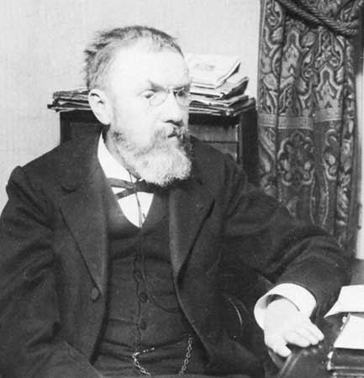
Tobias Dantzig

Slide 7
0/1 Knapsack problem
Determine a subset A of { 1, 2, …, n } that satisfies the following:
In 0/1 knapsack a specific item is either selected or not

Slide 8
Variations of the Knapsack problem
Fractions are allowed. This applies to items such as:
bread, for which taking half a loaf makes sense
gold dust
No fractions.
0/1 (1 brown pants, 1 green shirt…)
Allows putting many items of same type in knapsack
5 pairs of socks
10 gold bricks
More than one knapsack, etc.
First 0/1 knapsack problem will be covered then the Fractional knapsack problem.

Slide 9
Brute force!
Generate all 2^{n} subsets
Discard all subsets whose sum of the weights exceed W (not feasible)
Select the maximum total profit of the remaining (feasible) subsets
What is the run time? O(n 2^{n}), Omega(2^{n})
Lets try the obvious greedy strategy .

Slide 10
Example with “brute force”
S = { ( item₁ , 5, $70 ), (item₂ ,10, $90 ), ( item₃, 25, $140 ) } , W=25
Subsets:
1. {}
2. { ( item₁ , 5, $70 ) } Profit=$70
3. { (item₂ ,10, $90 ) } Profit=$90
4. { ( item₃, 25, $140 ) } Profit=$140
5. { ( item₁ , 5, $70 ), (item₂ ,10, $90 )}. Profit=$160 ****
6. { (item₂ ,10, $90 ), ( item₃, 25, $140 ) } exceeds W
7. { ( item₁ , 5, $70 ), ( item₃, 25, $140 ) } exceeds W
8. { ( item₁ , 5, $70 ), (item₂ ,10, $90 ), ( item₃, 25, $140 ) } exceeds W

Slide 11
Greedy 1: Selection Criteria: Maximum profitable item
S = { ( item₁ , 5, $70 ), (item₂ ,10, $90 ), ( item₃, 25, $140 ) }
$140
10 lb
W = 25lb
$90
$140
$70
5 lb
25 lb
$70
25 lb
10 lb
$90
5 lb
10 lb
item₁
item₂
item₃
Knapsack
Greedy Solution
=$140
Optimal Solution
=$160

Slide 12
Greedy 2: Selection criteria: Maximum weight item
S = { ( item₁ , 5, $150 ), (item₂ ,10, $60 ), ( item₃, 20, $140 ) }
5 lb
10 lb
$60
$140
W =
30lb
$140
20 lb
$60
20 lb
$150
10 lb
20 lb
$140
$150
5 lb
5 lb
item₁
item₂
item₃
Knapsack
Greedy Solution
Optimal Solution
=$200
=$290

Slide 13
Greedy 3: Selection criteria: Maximum profit per unit item
S = { ( item₁ , 5, $50 ), ( item₂, 20, $140 ) (item₃ ,10, $60 ) }
5 lb
P/W: $7
$140
W =
30lb
$140
20 lb
$140
P/W 2: $6
20 lb
P/W 1: $10
$60
20 lb
$50
10 lb
$60
10 lb
$50
5 lb
5 lb
item₁
item₂
item₃
Knapsack
Greedy Solution
=$190
Optimal Solution
=$200
Can you design an algorithm for this problem
and What is the asymptotic runtime of this algorithm?

Slide 14
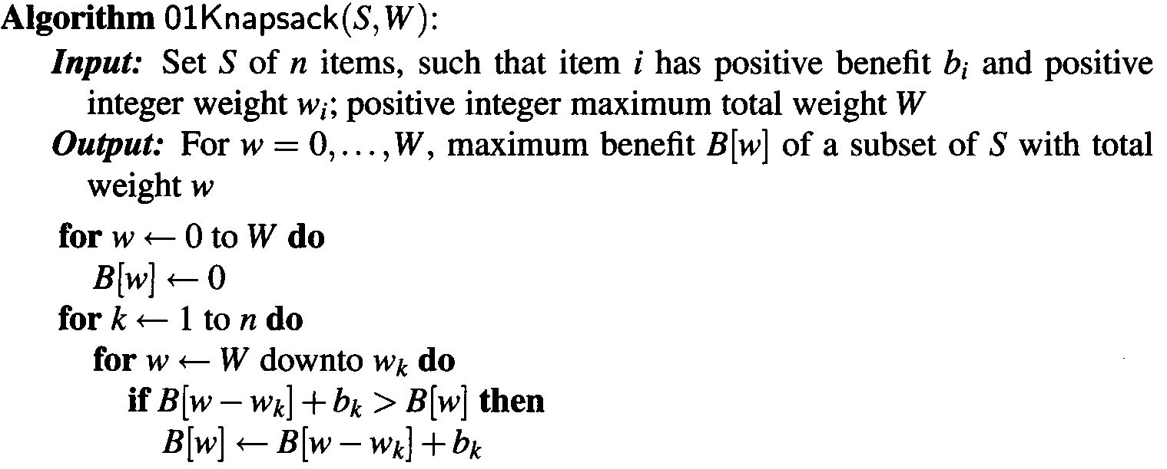
0-1 Knapsack Problem

Slide 15
0-1 Knapsack Problem
The running time of the 0-1Knapsack algorithm is dominated by the two nested for-loops, where the outer one iterates n times and the inner one iterates at most W times
0-1 Knapsack algorithm finds the highest profit subset of S with total weight at most W in O(nW) time

Slide 16
An Optimal Greedy Algorithm for Knapsack with Fractions (KWF)
In this problem a fraction of any item may be chosen.
The greedy algorithm uses the maximum profit per unit selection criteria
Sort items in decreasing p_{i} / w_{i}.
Add items to knapsack (starting at the first) until there are no more items, or the next item to be added exceeds W.
If knapsack is not yet full, fill knapsack with a fraction of next unselected item.
In this case, we let x_{i} denote the amount we take of item i
Objective: maximize
Constraint:

Slide 17
KWF
Let k be the index of the last item included in the knapsack. We may be able to include the whole or only a fraction of item k
Without item k totweight =
Profit KWF =
+ min{(W - totweight),w_{k} } X (p_{k} / w_{k} )
min{(W - totweight),w_{k} }, means that we either take the whole of item k when the knapsack can include the item without violating the constraint, or we fill the knapsack by a fraction of item

Slide 18
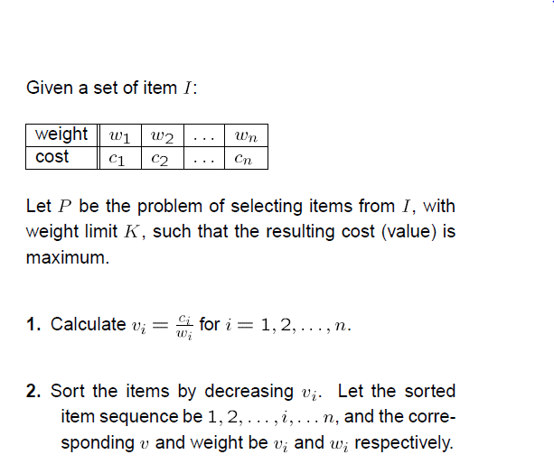
A Generic Example

Slide 19
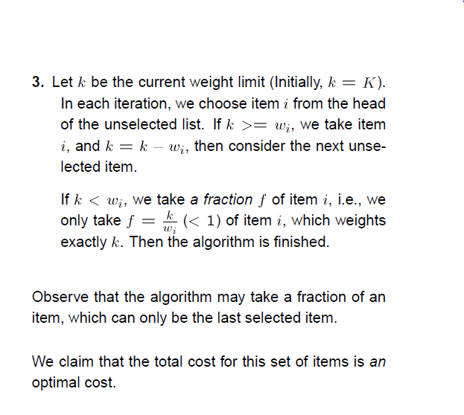

Slide 20
Example 1 of applying the optimal greedy algorithm for Fractional Knapsack Problem S = { ( item₁ , 5, $50 ), ( item₂, 20, $140 ) (item₃ ,10, $60 ) }
B/W: $7
5 lb
5/10 * $60 = $30
$140
30lb Max
Optimal
Profit $220
Solution:
items 1and 2
and 1/2 of
item 3
$140
B/W 2: $6
20 lb
B/W 1: $10
$60
20 lb
$50
10 lb
$50
5 lb
5 lb
item₁
item₂
item₃
Knapsack
Greedy Solution
=
Optimal Solution

Slide 21
Example of applying the optimal greedy algorithm for Fractional Knapsack Problem
W=30
S = { ( item1 , 5, $50 ), (item2 ,20, $140 ), ( item3, 10, $60 ) }
Note: items are already sorted by profit/weight
Applying the algorithm:
Current weight in knapsack=0, Current profit=0.
Can item 1 fit? 0+5<30 so select it. Current profit=0+50
Can item 2 fit? 5+20<30, so select. Current profit =50+140=190
Can item 3 fit? 25+10>30. No.
We can add 5 to knapsack (30-25).
So select 5/10=0.5 of item 3.
Current profit=190+30=220

Slide 22
Example 2
Given: A set S of n items, with each item i having
b_{i} - a positive profit
w_{i} - a positive weight
Goal: Choose items with maximum total profit but with weight at most W.
“knapsack”
Solution:
1 ml of 5
2 ml of 3
6 ml of 4
1 ml of 2
Items:
1
2
3
4
5
Weight:
4 ml
8 ml
2 ml
6 ml
1 ml
Profit:
$12
$32
$40
$30
$50
10 ml
Value:
3
4
20
5
50
($ per ml)

Slide 23
The Fractional Knapsack Algorithm
Greedy choice: Keep taking item with highest value (profit to weight ratio)
Since
Run time: O(n log n). Why?
Algorithm fractionalKnapsack(S, W)
Input: set S of items with profit p_{i} and weight w_{i}; max. weight W
Output: fraction x_{i} of each item i to maximize profit with weight at most W
for each item i in S
x_{i} ← 0
v_{i} ← p_{i} / w_{i} {value}
w ← 0 {total weight}
while w < W
remove item i with highest v_{i}
x_{i} ← min{w_{i} , W - w}
w ← w + min{w_{i} , W - w}

Slide 24
Elements of Greedy Strategy
An greedy algorithm makes a sequence of choices, each of the choices that seems best at the moment is chosen
NOT always produce an optimal solution
Two ingredients that are exhibited by most problems that lend themselves to a greedy strategy
Greedy-choice property
Optimal substructure

Slide 25
Greedy-Choice Property
A globally optimal solution can be arrived at by making a locally optimal (greedy) choice
Make whatever choice seems best at the moment and then solve the sub-problem arising after the choice is made E.g. Chess moves
The choice made by a greedy algorithm may depend on choices so far, but it cannot depend on any future choices or on the solutions to sub-problems E.g. Chess moves
Of course, we must prove that a greedy choice at each step yields a globally optimal solution

Slide 26
Optimal Substructures
A problem exhibits optimal substructure if an optimal solution to the problem contains within it optimal solutions to sub-problems
0-1: If item j is removed from an optimal packing, the remaining packing is an optimal packing with weight at most W-w_{j}
Fractional: If w pounds of item j is removed from an optimal packing, the remaining packing is an optimal packing with weight at most W-w that can be taken from other n-1 items plus w_{j} – w of item j

Slide 27
Other Greedy Problems
Coin Changing
Task Scheduling
Minimum Spanning Tree
Dijkstra's Single-Source Shortest-Path, All Source Shortest Path,
The vehicle routing problem (VRP)
Travelling salesman problem

Slide 28
Huffman Codes

Slide 29
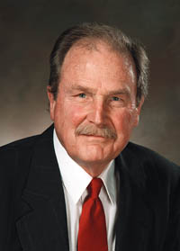
David Huffman’s idea
A Term paper at MIT
Build the tree (code) bottom-up in a greedy fashion
Origami aficionado

Slide 30
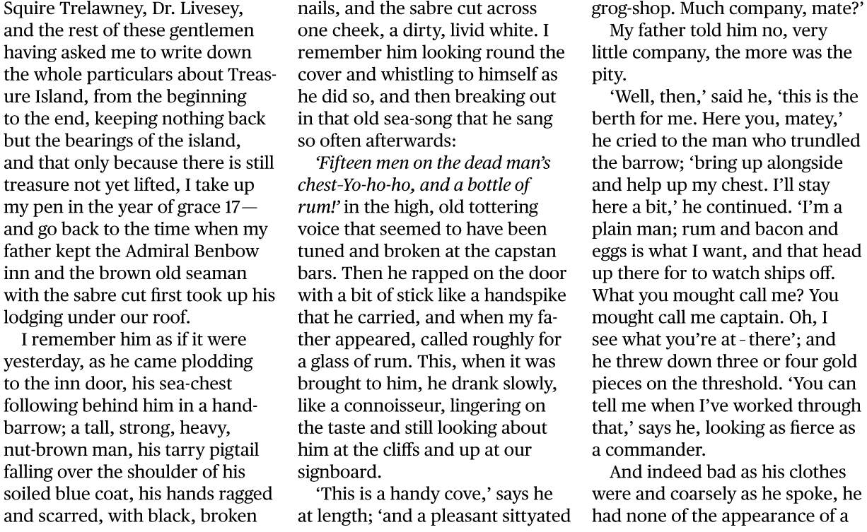
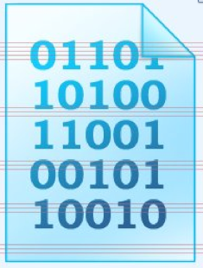
Huffman Coding
Huffman coding
Compressed file
Original file
A technique to compress data effectively
Usually between 20%-90% compression
Lossless compression
No information is lost
When decompress, you get the original file

Slide 31
Huffman Coding: Applications
Huffman coding
Compressed file
Original file
Saving space
Store compressed files instead of original files
Transmitting files or data
Send compressed data to save transmission time and power
Encryption and decryption
Cannot read the compressed file without knowing the “key”

Slide 32
Encoding messages
Encode a message composed of a string of characters
Codes used by computer systems
ASCII
uses 8 bits per character
can encode 256 characters
Unicode
16 bits per character
can encode 65536 characters
includes all characters encoded by ASCII
ASCII and Unicode are fixed-length codes
all characters represented by same number of bits

Slide 33
Problems
Suppose that we want to encode a message constructed from the symbols A, B, C, D, and E using a fixed-length code
How many bits are required to encode each symbol?
at least 3 bits are required
2 bits are not enough (can only encode four symbols)
How many bits are required to encode the message DEAACAAAAABA?
there are twelve symbols, each requires 3 bits
12*3 = 36 bits are required

Slide 34
Drawbacks of fixed-length codes
Wasted space
Unicode uses twice as much space as ASCII
inefficient for plain-text messages containing only ASCII characters
Same number of bits used to represent all characters
‘a’ and ‘e’ occur more frequently than ‘q’ and ‘z’
Potential solution: use variable-length codes
variable number of bits to represent characters when frequency of occurrence is known
short codes for characters that occur frequently

Slide 35
Advantages of variable-length codes
The advantage of variable-length codes over fixed-length is short codes can be given to characters that occur frequently
on average, the length of the encoded message is less than fixed-length encoding
Potential problem: how do we know where one character ends and another begins?
not a problem if number of bits is fixed!
A = 00
B = 01
C = 10
D = 11
0010110111001111111111
A C D B A D D D D D

Slide 36
Prefix property
A code has the prefix property if no character code is the prefix (start of the code) for another character
Example:
000 is not a prefix of 11, 01, 001, or 10
11 is not a prefix of 000, 01, 001, or 10 …
Symbol | Code
P | 000
Q | 11
R | 01
S | 001
T | 10
01001101100010
R S T Q P T

Slide 37
Code without prefix property
The following code does not have prefix property
The pattern 1110 can be decoded as QQQP, QTP, QQS, or TS
Symbol | Code
P | 0
Q | 1
R | 01
S | 10
T | 11

Slide 38
Problem
Design a variable-length prefix-free code such that the message DEAACAAAAABA can be encoded using 22 bits
Possible solution:
A occurs eight times while B, C, D, and E each occur once
represent A with a one bit code, say 0
remaining codes cannot start with 0
represent B with the two bit code 10
remaining codes cannot start with 0 or 10
represent C with 110
represent D with 1110
represent E with 11110

Slide 39
Encoded message
DEAACAAAAABA
Symbol | Code
A | 0
B | 10
C | 110
D | 1110
E | 11110
1110111100011000000100
22 bits

Slide 40
Another possible code
DEAACAAAAABA
Symbol | Code
A | 0
B | 100
C | 101
D | 1101
E | 1111
1101111100101000001000
22 bits

Slide 41
Better code
DEAACAAAAABA
Symbol | Code
A | 0
B | 100
C | 101
D | 110
E | 111
11011100101000001000
20 bits

Slide 42
What code to use?
Question: Is there a variable-length code that makes the most efficient use of space?
Answer: Yes!

Slide 43
Purpose of Huffman Coding
Proposed by Dr. David A. Huffman in 1952
“A Method for the Construction of Minimum Redundancy Codes”
Applicable to many forms of data transmission
Our example: text files

Slide 44
Huffman coding tree
Binary tree
each leaf contains symbol (character)
label edge from node to left child with 0
label edge from node to right child with 1
Code for any symbol obtained by following path from root to the leaf containing symbol
Code has prefix property
leaf node cannot appear on path to another leaf
note: fixed-length codes are represented by a complete Huffman tree and clearly have the prefix property

Slide 45
Building a Huffman tree
Find frequencies of each symbol occurring in message
Begin with a forest of single node trees
each contain symbol and its frequency
Do recursively
select two trees with smallest frequency at the root
produce a new binary tree with the selected trees as children and store the sum of their frequencies in the root
Recursion ends when there is one tree
this is the Huffman coding tree

Slide 46
Example
Build the Huffman coding tree for the message
This is his message
Character frequencies
Begin with forest of single trees
A | G | M | T | E | H | _ | I | S
1 | 1 | 1 | 1 | 2 | 2 | 3 | 3 | 5
1
1
1
1
2
2
3
3
5
A
G
M
T
E
H
_
I
S

Slide 47
Step 1
2
1
1
1
1
2
2
3
3
5
A
G
M
T
E
H
_
I
S

Slide 48
Step 2
2
2
1
1
1
1
2
2
3
3
5
A
G
M
T
E
H
_
I
S

Slide 49
Step 3
2
2
4
1
1
1
1
2
2
3
3
5
A
G
M
T
E
H
_
I
S

Slide 50
Step 4
4
2
2
4
1
1
1
1
2
2
3
3
5
A
G
M
T
E
H
_
I
S

Slide 51
Step 5
4
2
2
4
6
1
1
1
1
2
2
3
3
5
A
G
M
T
E
H
_
I
S

Slide 52
Step 6
8
4
4
2
2
2
2
6
E
H
1
1
1
1
3
3
5
A
G
M
T
_
I
S

Slide 53
Step 7
8
11
4
4
6
5
S
2
2
2
2
3
3
E
H
_
I
1
1
1
1
A
G
M
T

Slide 54
Step 8
19
8
11
4
4
6
5
S
2
2
2
2
3
3
E
H
_
I
1
1
1
1
A
G
M
T

Slide 55
Label edges
19
0
1
8
11
0
1
0
1
4
4
6
5
0
1
0
1
0
1
S
2
2
2
2
3
3
0
1
0
1
E
H
_
I
1
1
1
1
A
G
M
T

Slide 56
Huffman code & encoded message
This is his message
S 11
E 010
H 011
_ 100
I 101
A 0000
G 0001
M 0010
T 0011
00110111011110010111100011101111000010010111100000001010

Slide 57
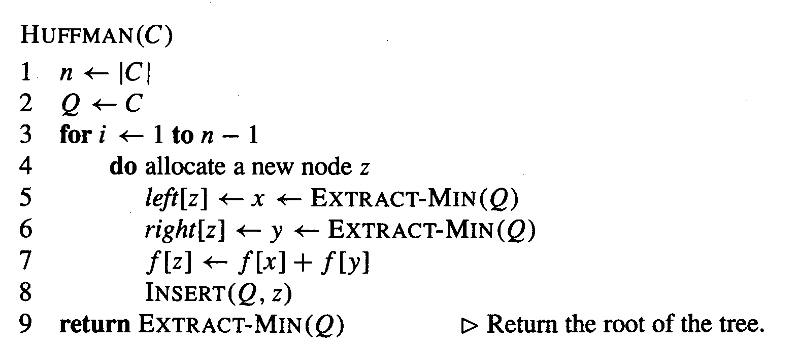
The Algorithm
An appropriate data structure is a binary min-heap ( We will deal later!)
Rebuilding the heap is lg n and n-1 extractions are made, so the complexity is O( n lg n )
The encoding is NOT unique, other encoding may work just as well, but none will work better.

Slide 58
Huffman Code Properties
Greedy algorithm
Chooses best local solution at each step
Combines 2 trees with lowest frequency
Still yields overall best solution
Optimal prefix code
Based on statistical frequency
Better compression possible (depends on data)
Using other approaches (e.g., pattern dictionary)

Slide 59
How did I get a learn Huffman Codes
That was my entire PhD work!...

Slide 60
Home Work – Generate Huffman Coding for the given information
Yourfirstname City State Country

Slide 61
Other Algorithm Categories
Brute Force
Bubble Sort, Selection Sort
Divide-and-Conquer
Merge Sort and Quicksort
Decrease-and-Conquer
Insertion Sort
Transform-and-Conquer
Heapsort
Dynamic Programming
Greedy Algorithms
Iterative Improvement
Simplex Method, Maximum Flow
From The Design & Analysis of Algorithms, Levitin

Slide 62
To Read
Chapter 16 of CLRS(16.1, 16.2 and 16.3)

